Slide 1
Objects In My Home
Please cut out each picture with its name and tape around your house.

Slide 2
Refrigerator

Slide 3
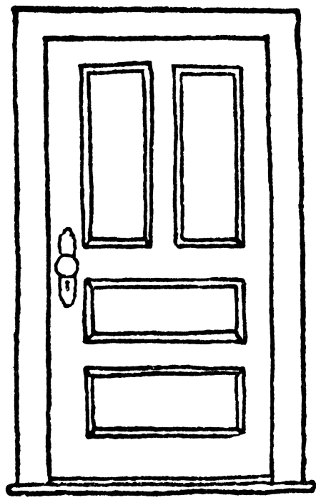
D door

Slide 4
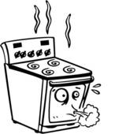
stove

Slide 5
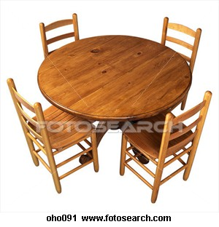
Table and chairs

Slide 6
bed

Slide 7
television

Slide 8
telephone

Slide 9
computer

