Slide 1
Colors
Feel free to review the basic colors with your child.

Slide 2
Red

Slide 3
Yellow

Slide 4
Green

Slide 5
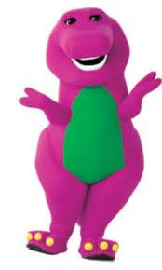
Purple

Slide 6
Blue

Slide 7
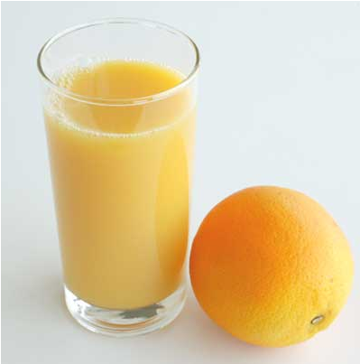
Orange

Slide 8
Pink

